Slide 1




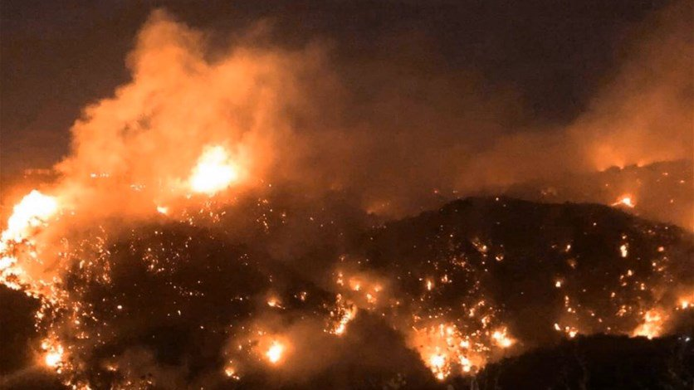

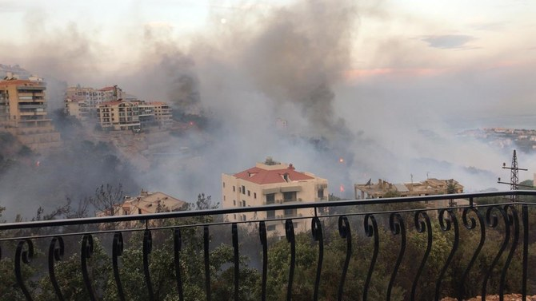
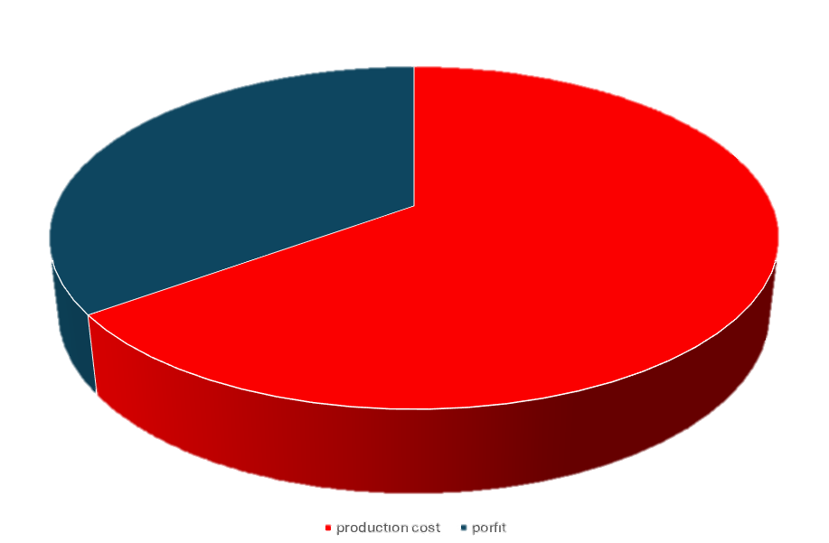
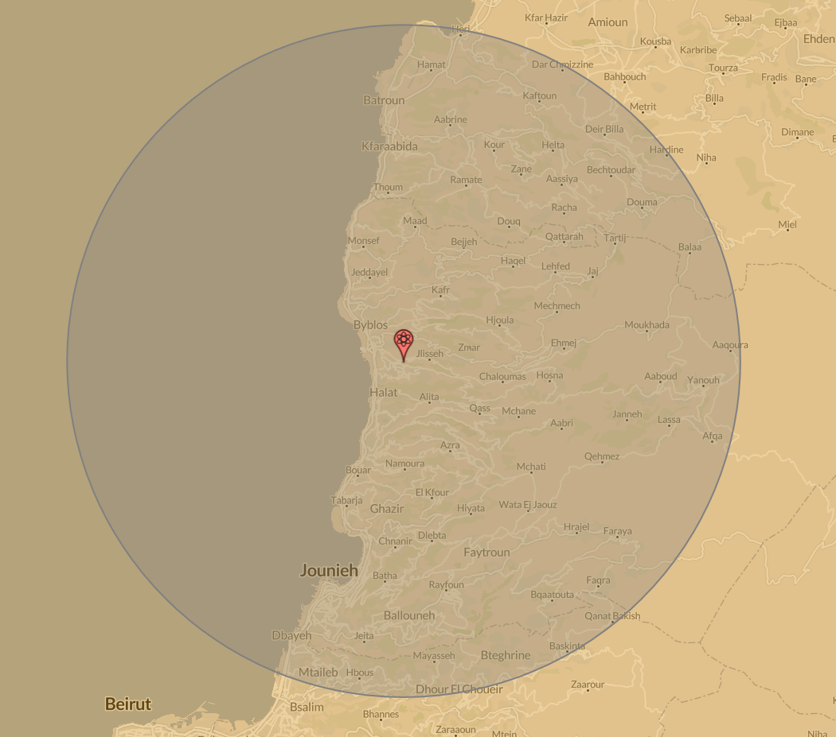
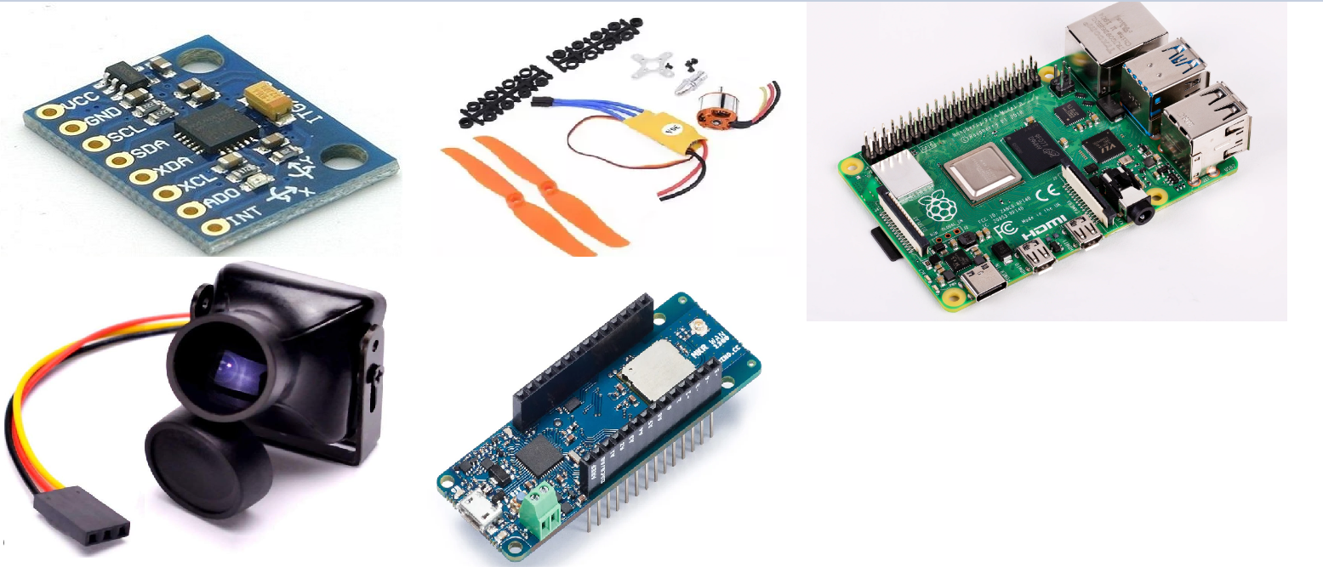
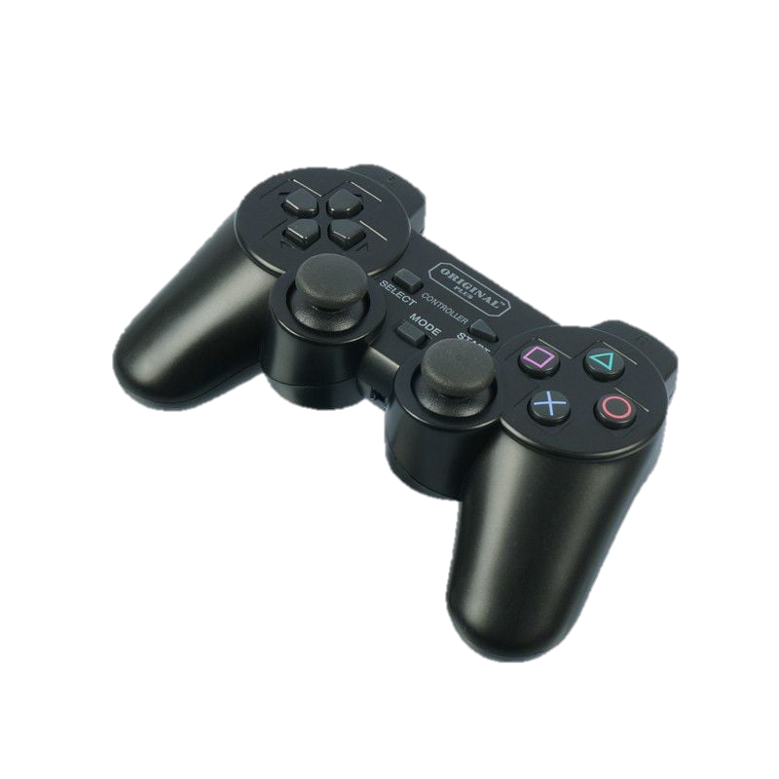
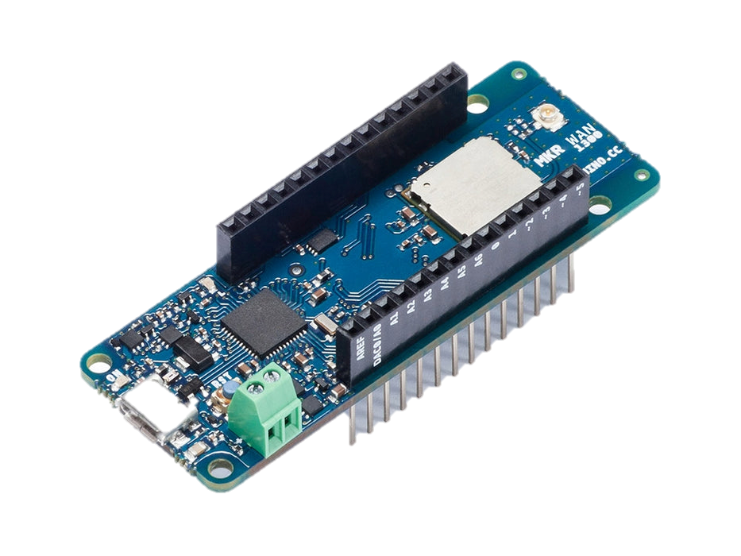
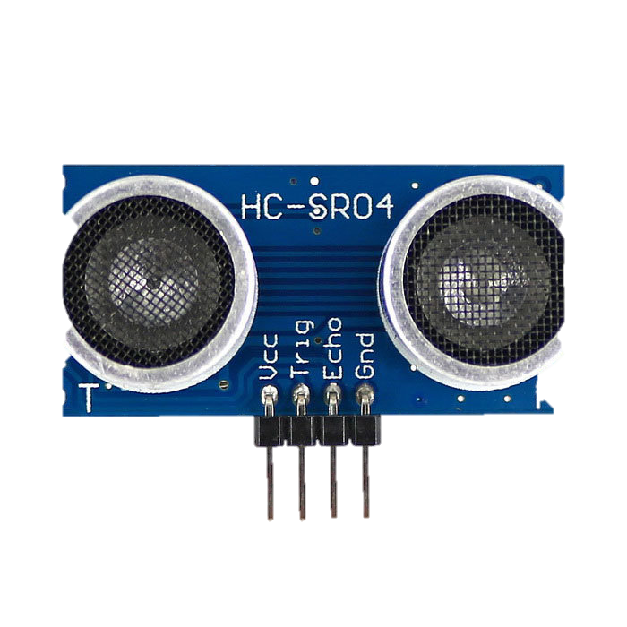
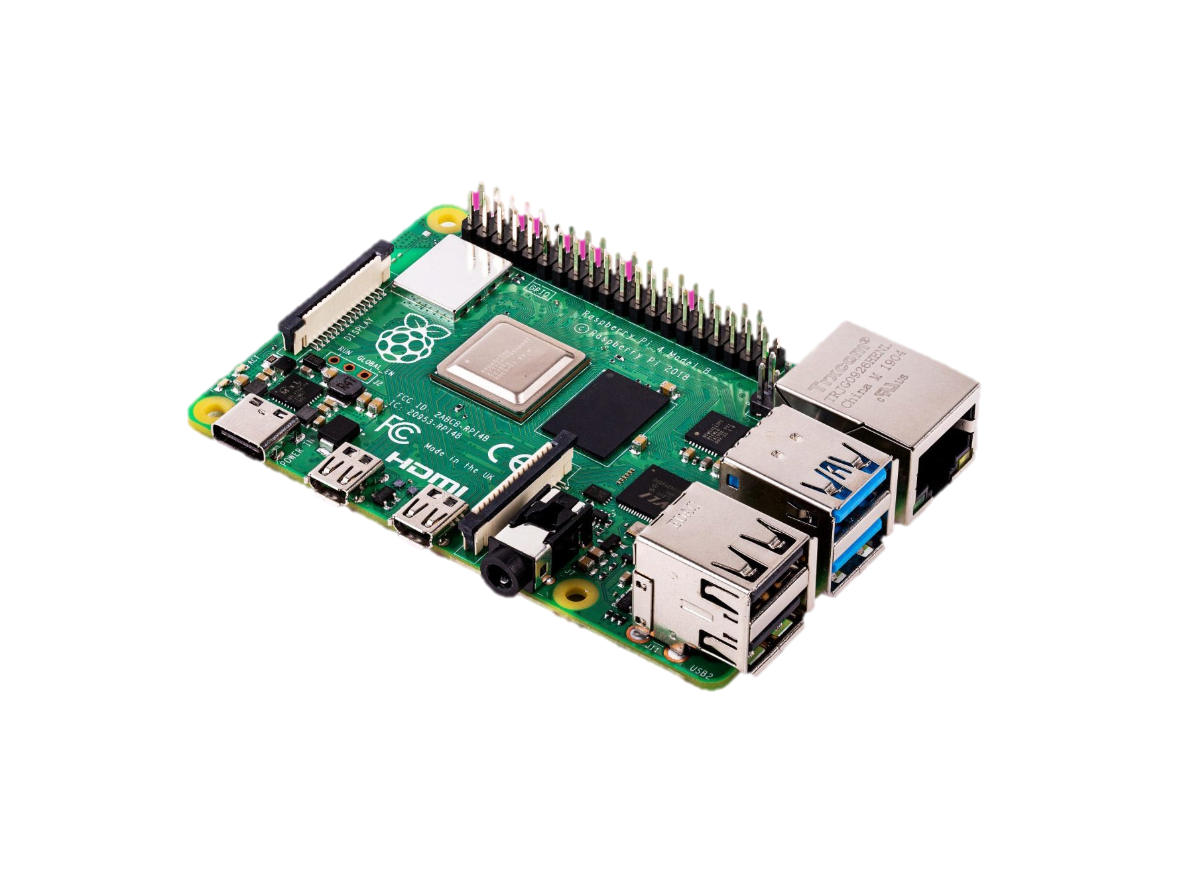
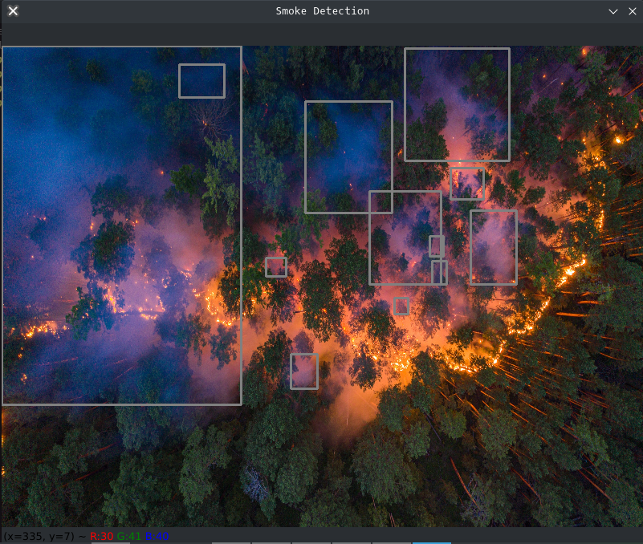
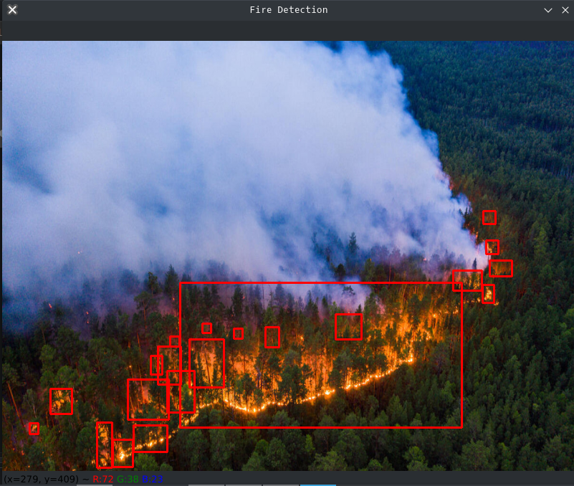
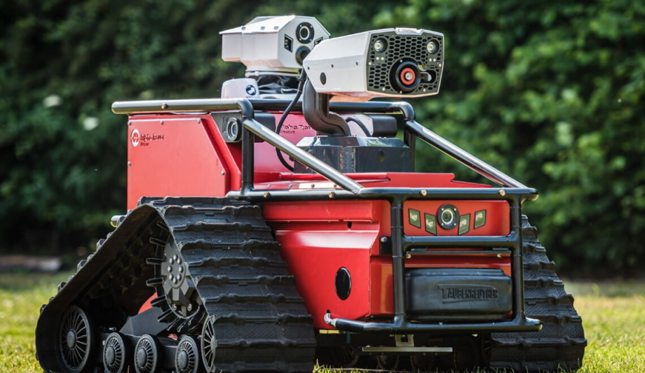
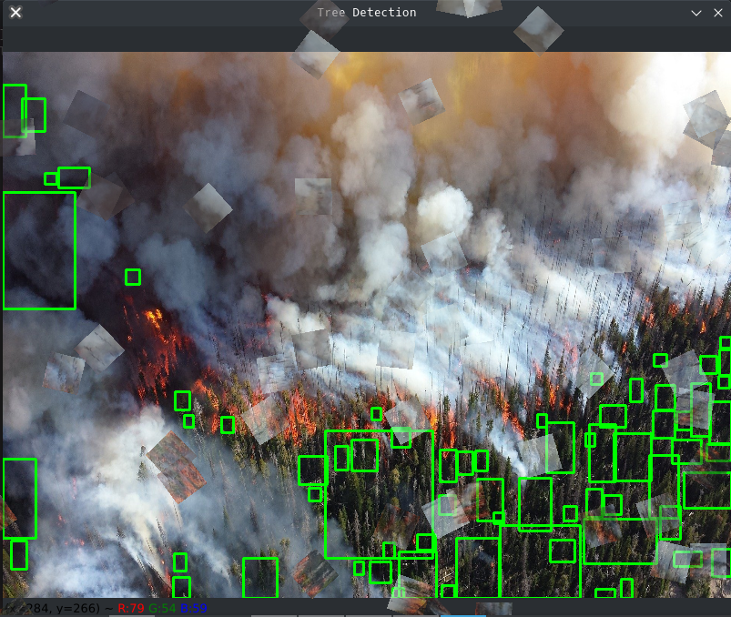
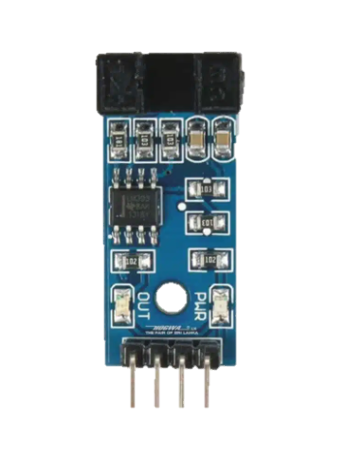
INSERT LOGO HERE
INSERT LOGO HERE
Scotlia
Abed Al Rida Nehme, Mohamad Ghoush , Reina Al Hariri , Roxane Mezher Beirut Arab University, Debbiyeh Campus, Faculty of Engineering, Department of Electrical and Computer Engineering
Introduction
Altering The Column Layout
A BFS proximity algorithm is then used to plot a heatmap inferring the priority to extinguish fires based on criteria:
Wind direction and speed skews the priority heatmap in favor of fire spreading.
Firefighting Drone Technology.
In today's world, where wildfires(Debbieh October 15, 2019) (Figure 1) and urban fires (Debbieh October 16, 2019) (Figure 2), pose increasing challenges, the integration of drone technology promises a revolutionary approach to fire management and rescue operations.
Join us on a journey to explore the capabilities of these firefighting drones, from their ability to map fire zones in real time to their role in delivering firefighting agents and performing reconnaissance missions in hazardous environments. We aim to demonstrate how these drones can enhance the safety of firefighters, protect communities, and mitigate the impact of fire disasters.
The public sector and emergency agencies and NGOs) (Figure 6,7,8), such as Lebanese Red Cross will benefit from this system. There is no other system in the market that does what our system does, making it one of its kind, and extremely valuable for what it offers at its current price.
Higher priority is given to fire going into human property
Normal priority is given to fire spreading to larger masses of biomass
Low priority is given to fire that won’t spread and won’t cause harm
Finally, the heatmap is displayed on the server.
Figure 6
Figure 7
Figure 8
Let the money talk
At a sales profit of 35%, a complete drone system can be sold at 607$(Figure 9); in addition to that, maintenance fees will add up to the revenue.
Meanwhile, the marketing will be done through industry conferences and partnerships with humanitarian organizations.
Figure 1
Figure 2
Why did we use this technology?
Conclusion
Time is a crucial part of fighting wildfires, and inefficiency in extinguishing the fire can lead to the loss of lives and tons of biomass and risk of fire spreading into human property.
The aim of this project is to develop a cheap, autonomous system that will help firefighters figure out the highest priority areas to extinguish in cascading bursts, increasing time-efficiency and saving lives and biomass and preventing the fire from spreading to human property.
A drone is estimated to cost around 450$, covering an estimated 20km area(Figure 3), making it a viable solution compared to other technologies used in crisis aversion.
The drone we implemented includes widely available and standard educational equipment (Figure 4), which means that resources to build this drone are widely available and manufacturing won’t be an issue.
By leveraging the unique capabilities of firefighting drones, we can revolutionize fire management, enhance firefighter safety, and ultimately save lives and property.
Figure 9
Technical Details
A quad copter controlled with Arduino MKR 1300(Figure 10) is equipped with a camera, receives controls from the station’s Arduino MKR 1300 and sends aerial images to the station’s Arduino via LoRa communication.
Note that the quadcopter’s Arduino is equipped with IR ultrasonic sensors (Figure 11) for obstacle avoidance.
A PS2 controller (Figure 12) linked wirelessly to the station’s Arduino MKR 1300 is used to control the drone via LoRa communication. Images are taken periodically, received by the station, and are sent to the Raspberry Pi 4 (Figure 13) via USB connection, to be shown on a Flask server HTML page, hosted on the pi4, as a low FPS video stream.
Press Start on the PS2 controller to take the image designated for processing. The image will then be passed to an OpenCV script to detect bounding boxes for trees (Figure 14) and smoke (Figure 15) and fire (Figure 16) and human property, utilizing a pretrained Fast R-CNN model fine tuned to aerial wildfire images dataset publicly available on Kaggle.
Acknowledgements
Special thanks to the Faculty of Engineering LAU for this opportunity,to all the faculty staff at BAU who helped us at critical moments.
Moreover, a wind direction and speed sensor (Figure 17) are connected to the site’s Arduino MKR 1300, continuously collecting environmental data, then the data is sent to the Raspberry Pi 4 to be used later for decision making.
Figure 3
Figure 4
Future potential and Scalability
Figure 10
Figure 11
Figure 12
Contact Information
The drone system is designed to be integrated with future developments in emergency response robotics, like human rescue rovers(Figure 5), making it highly potent in the future with features such as autonomous robotic control, traveling salesman implementation, and serving as a communication means in the crisis area.
Corresponding author’s Name
Address | Tel: +1 066 - 666666 Fax: +1 066 - 777777 Email: author@address.org Web: www.yourwebsite.org
Figure 13
Figure 14
Figure 15
Figure 5
Figure 16
Figure 17

